Slide 1
UIDAI Hackathon Documentation
Team Reference ID : oddnj9G40C
Team Member Details
SL. No | Name | Email ID
1 | Rahul Biswas | biswasrahul180101@gmail.com
2 | Spandita Biswas | spoon2733@gmail.com
3 | Saniya Bhargav | saniyabhargav@gmail.com
4 | Mayank Jain | jainmayank2509@gmail.com
5 | Sagar Satapathy | wishsagarks@gmail.com

Slide 2
About the Problem Statement
Theme : Authentication Reimagined
Problem Statement:
Indian citizens are witnessing a period of hypergrowth in the Smartphone domain. 4G based Smartphone subscription in India is set to grow from 680 million in 2020 to 830 million in 2026, increasing at a CAGR of 3 percent. With the introduction of 5G, it is expected that around 26 million subscribers will migrate to this new technology by the end of 2026. Smartphones will become an important device for every resident and would be the de facto instrument to interface with Digital India. UIDAI intends to leverage this behavioral change in the life of a citizen and would like to reimagine the authentication and identity platform. In addition, these changes intend to improve the usability, security, and privacy of Aadhaar Authentication.

Slide 3
About the Problem Statement
Theme : Authentication Reimagined
Problem Statement:
Indian citizens are witnessing a period of hypergrowth in the Smartphone domain. 4G based Smartphone subscription in India is set to grow from 680 million in 2020 to 830 million in 2026, increasing at a CAGR of 3 percent. With the introduction of 5G, it is expected that around 26 million subscribers will migrate to this new technology by the end of 2026. Smartphones will become an important device for every resident and would be the de facto instrument to interface with Digital India. UIDAI intends to leverage this behavioral change in the life of a citizen and would like to reimagine the authentication and identity platform. In addition, these changes intend to improve the usability, security, and privacy of Aadhaar Authentication.

Slide 4
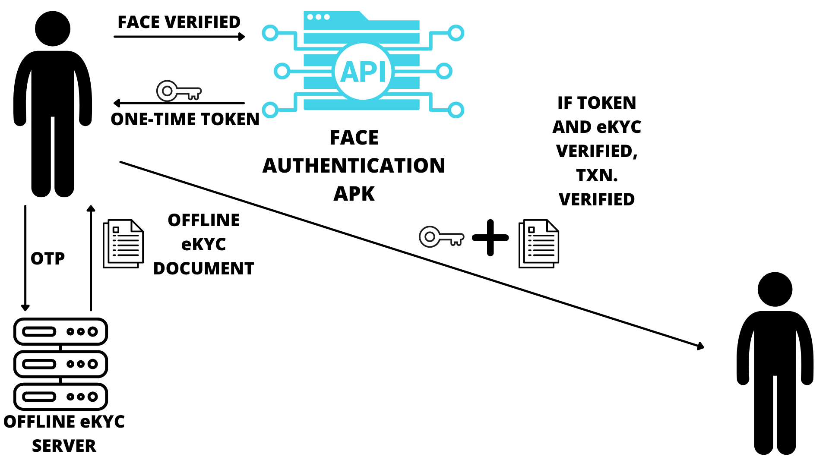
Architectural Diagram

Slide 5
API Usage
Aadhar Authentication API
Face Authentication APK
VID API
Offline eKYC API

Slide 6
Aadhar Authentication API
URL: • https://stage1.uidai.gov.in/onlineekyc/getAuth/
Aadhaar authentication is the process wherein Aadhaar Number or Virtual ID
or UID Token, along with other attributes, including biometrics, are submitted online to
the CIDR for its verification on the basis of information or data or documents available
with it. By using this API, we verified the authenticity of the person in any offline eKYC center. We send an input parameter to the server. In turn, the server sends us an OTP which we use to verify the authenticity of the person and to check his/her ID validity.

Slide 7
Aadhar Authentication API
Example Scenario 1
Operator-assisted transaction
Aadhaar number holder provides Aadhaar Number or Virtual ID
Aadhaar authentication enabled application software that is installed on the device packages these input parameters, encrypts, and sends it to AUA server over either a mobile/broadband network using a secure protocol such as HTTPS.
AUA server, after validation, adds necessary headers and passes the request through ASA server to UIDAI CIDR.
Aadhaar authentication server returns a “yes/no” based on the match of the input parameters.
Based on the response from the Aadhaar authentication server, AUA/Sub-AUA conducts the transaction.

Slide 8
Aadhar Authentication API
Example Scenario 2
Assisted transaction on mobile
In this case, transaction data is captured on the mobile/Internet application provided by AUA/Sub-AUA.
Aadhaar number holder provides necessary demographic data long with OTP in addition to AUA specific attributes.
Aadhaar authentication enabled application software that is installed on the device packages these input parameters, encrypts, and sends it to AUA server over either a mobile/broadband network using a secure protocol such as HTTPS.
Further steps remain same as scenario 1.

Slide 9
Face Authentication APK
URL: • https://resident.uidai.gov.in/offline-kyc
After face verification, the user receives a token, whcih along with the eKYC document is encrypted with the public key of the third party. The token received is used as a password for unlocking the eKYC document and after verification, the transaction is permitted to proceed.

Slide 10
VID API
VID Wrapper API is used to generate and retrieve a Virtual ID (VID) for a given Aadhaar Number.
First, the user will be using a client application through which captcha request
will be the sent. The captcha is required to generate OTP for the user. After successful generation of captcha , OTP generation is triggered. After successful generation of OTP, A Virtual ID for the user is generated.

Slide 11
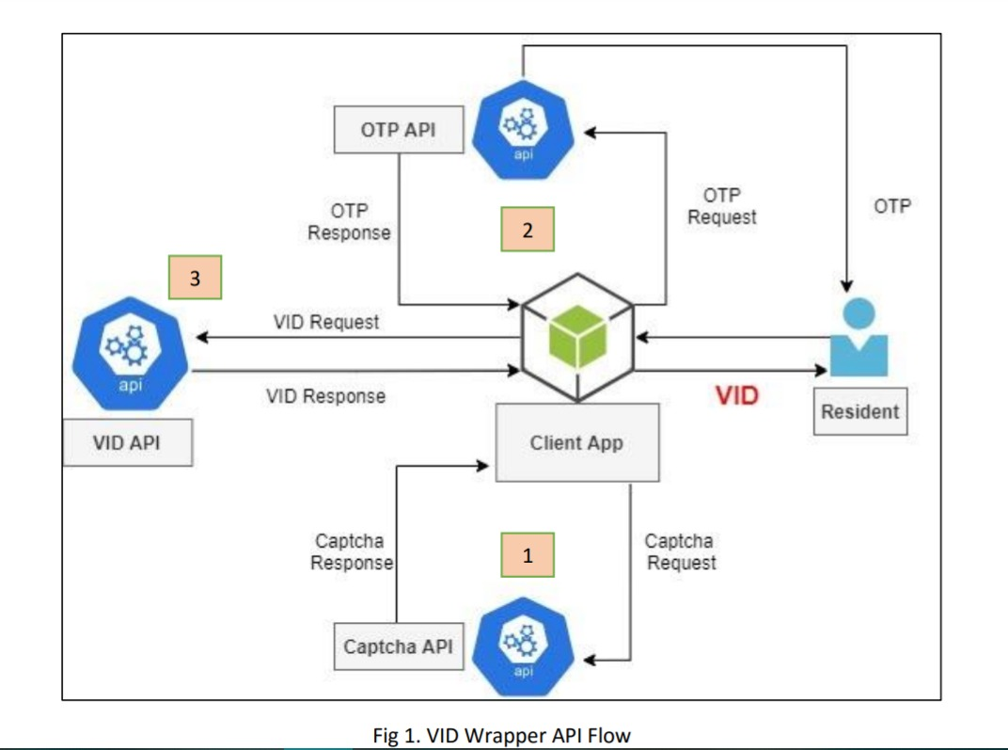

Slide 12
Offline eKYC API
EKYC API returns a ZIP file containing the user’s Paperless Offline eKYC which is digitally signed by UIDAI. First, the user will be using a client application through which captcha request will be the sent. The captcha is required to generate OTP for the user. After successful generation of captcha , OTP generation is triggered. After successful generation of OTP, A Virtual ID for the user is generated.
For successful verification of the user, both the one time token returned by the face-authentication APK, as well as, the offline eKYC document returned by the server need to be verified.

Slide 13
Security Considerations
Initial verification will be done by the customer and the third-party via the bank account information.
For further verification, the third-party will use the one-time token generated by the customer via the face authentication APK and will verify it against the offline eKYC generated via the customer’s OTP. In this way, two-step redundant verification will be performed which will help in fraud prevention.

